Slide 1
Concrete Analysis
NPV Activity
Team #7
Ananth
Akshay
Anoop
Balamurugan
Uma

Slide 2
Preliminary Analysis and Data Cleaning
The data set provided consists of various materials and factors which basically affects the concrete strength.
The data provided has 1030 different combinations and 9 columns which are:
Cement slag ash water superplastic coarseagg fineagg age strength
By analysing the columns we came to a conclusion that we have to find which material or the factor affects the strength of the concrete directly or inversely.
Removal of Duplicates and Substitution of Values which make analysis easier (example:- removal of rows with column values 0 and removal of duplicate rows of interest)
Slicing of data i.e. Focus on the columns and rows of interest-eg: Cement & Water, Coarse Agg, Fine Agg, etc
Utilized the numpy, Panda’s, seaborn, matplotlib Libraries to do the initial analysis - describe(), info(), plot(), corr(), replace(), hist()
Visualization using - hist, Bar plots, Scatter plots, Heat Maps, line plots,regression plot.

Slide 3
Project Statements
What is the effect of superplastic and ash on compressive strength ?
Does the water content have an impact on the strength ?
Does the age factor impact the strength of the concrete ?
Study the Strength of Concrete by Mixing Fly Ash and Slag with cement quantity
What is the role of the Coarse and Fine Aggregate along with Cement in giving the strength to the concrete mix?

Slide 4
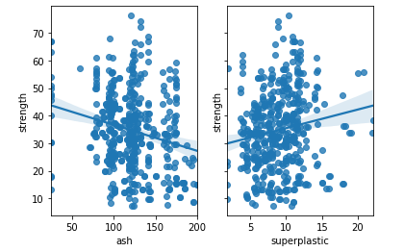
Question: What is the effect of superplastic & Ash on the compressive strength of Concrete ?
Analysis:
Preliminary analysis:
Preliminary analysis shows that Superplastic and Ash can be a good composition in improving the strength of concrete.
Conclusion :
Compressive strength(strength) decreases with the increase in Ash.
Compressive strength(strength) increases with the increase in superplastic.

Slide 5
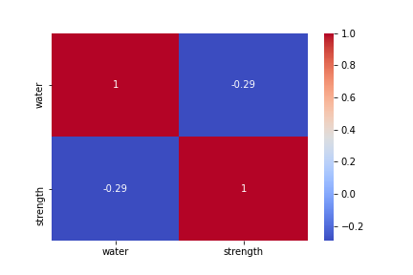
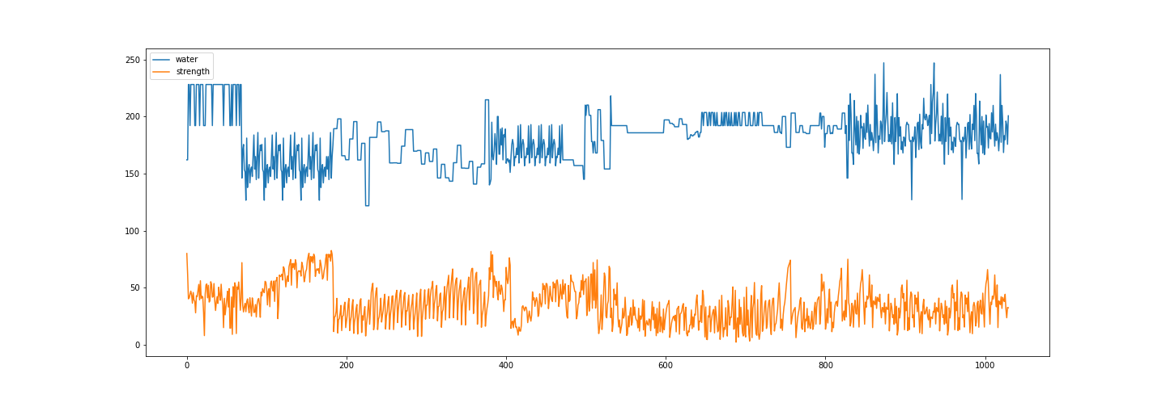
Does the water content have an impact on the strength ?
In the heat map, the strength has a negative correlation with the water and tend to decrease as the water increases.
Conclusion :
Water content does have an impact on the concrete strength.
Higher water-to-cement ratios result in greater spacing between the aggregates in cement, which affects compaction. Similarly, increased moisture levels reduce the concrete’s compressive strength and durability. As concrete’s surface area increases, particularly with the addition of fine aggregates, so does the demand for water. The increased water leads to a higher water-to-cement ratio.
When excess water creates greater spaces between aggregate materials, the voids fill with air after the moisture evaporates. The resulting inadequate compaction reduces the concrete’s strength.

Slide 6
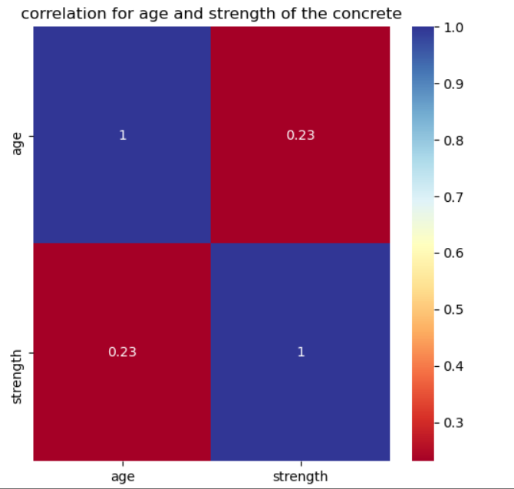
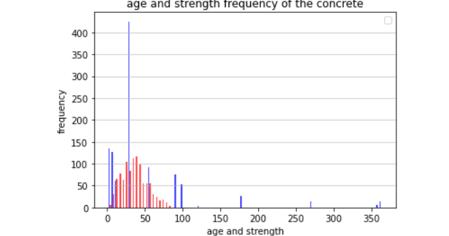
Does the age factor impact the strength of the concrete ?
Preliminary analysis:
Heat map shows that there is a positive relationship between the age and the strength.i.e)correlation=0.23.In the age and strength there is no null values.
Histogram shows the frequency of the age and strength in the given concrete data.Occurance of age 28 is more here.Blue bar denotes the age,red bar denotes the strength
Conclusion1:
Age is more positively related with Strength of the concrete. Curing time gives more strength to the concrete.
Conclusion2:
Age is having more frequency than the strength in the given data

Slide 7
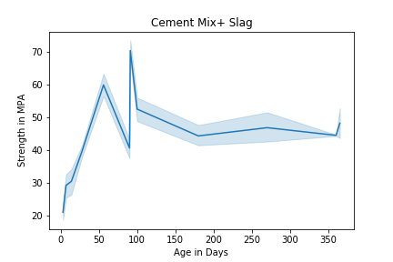
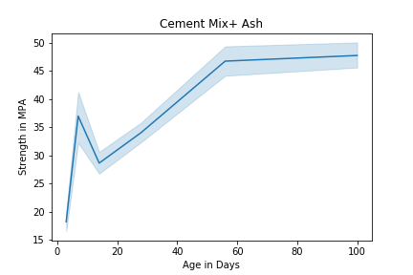
Study the Strength of Concrete by Mixing Fly Ash & Slag with cement quantity
Fly Ash : Waste from thermal Plants
Slag : Waste from Iron and Steel Industry
Analysis using Cement+Slag
Dg max strength using Cement+Slag : 82.6 Mpa
min strength using Cement+Slag : 2.33 Mpa
This mixture takes more initial time to set as we can see that the stre strength is less at first but over age the concrete strength
increases
Analysis using Cement+Ash
max strength using Cement+Ash : 76.24 Mpa
min strength using Cement+Ash : 7.32 Mpa
This mixture sets at a faster rate at initial but with the
Age the strength is less when compared with Slag .
Conclusion: Slag and Fly Ash are a good agent as they reduce the overall cost and substitutes the cement

Slide 8
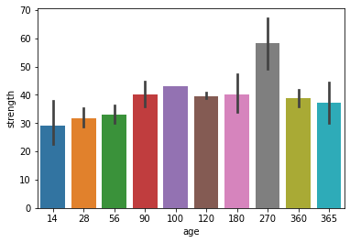
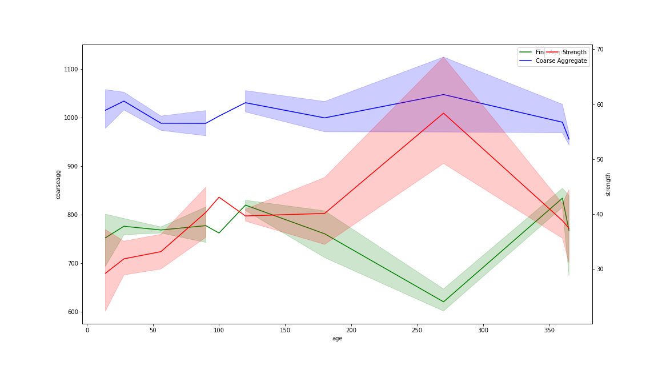
Question:
What is the role of the Coarse and Fine Aggregate along with Cement in giving the strength to the concrete mix?
Preliminary Analysis - Coarse and Fine Aggregates have maybe water or its proportion (ratio of the cement to coarse and fine agg) which influences the strength with age.
Conclusion
The mix of Fine and Coarse aggregate needs to be of certain proportion to have good strength
Proportion of the Coarse and Fine Aggregate Mix has an influence on the Strength and Strength increases with the Coarse aggregate
Beyond a certain level of Fine Aggregate, the Strength of the Concrete decreases

